Slide 1
InternshipStudio Internship for Ethical Hacking
TASK - 3

Slide 2
STEPS TO PERFORM XSS
Use Burpsuite to perform this task.
Open FireFox and set proxy settings as Burpsuite proxy
Visit http://testasp.vulnweb.com/
Click search on the site
Try XSS script <script>alert(5)</script> in the search box
Turn on intercept in Burpsuite
Click Forward in Burpsuite
Now forward the response to intruder in Burpsuite
In intruder section, post XSS scripts and click start attack
Check which XSS script intruded, copy the response of it and paste it in FireFox browser to check how it works
Here <script>alert(5)</script> works and gives response of script injection

Slide 3
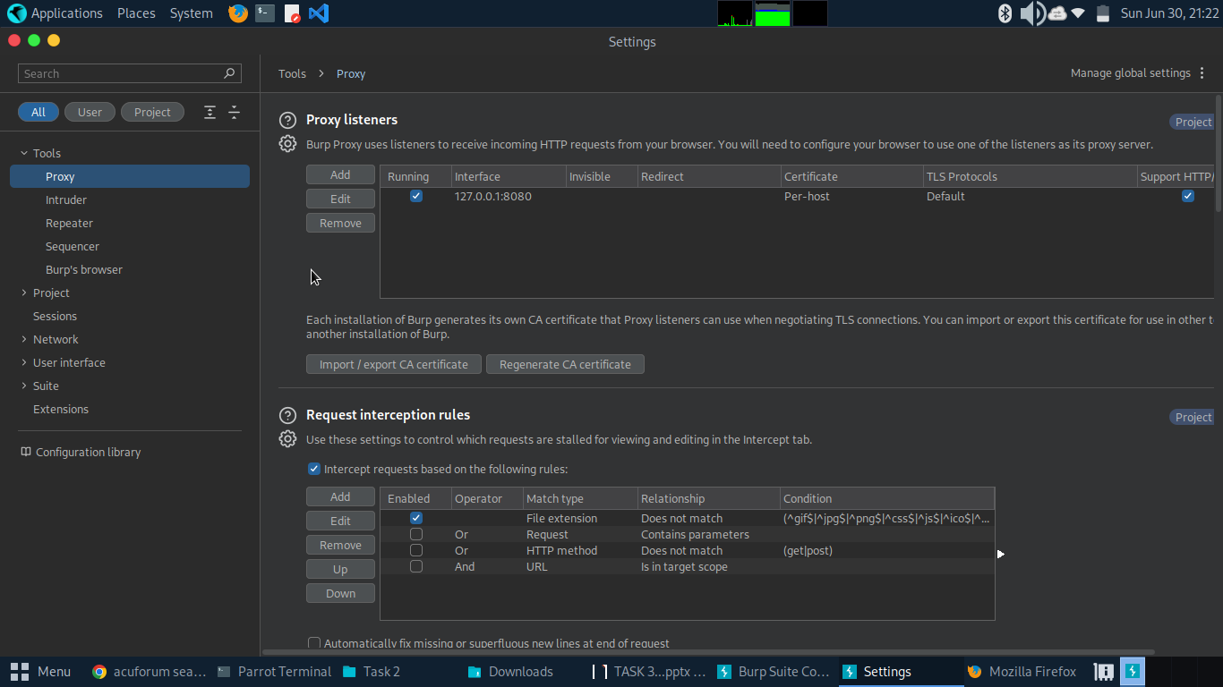

Slide 4
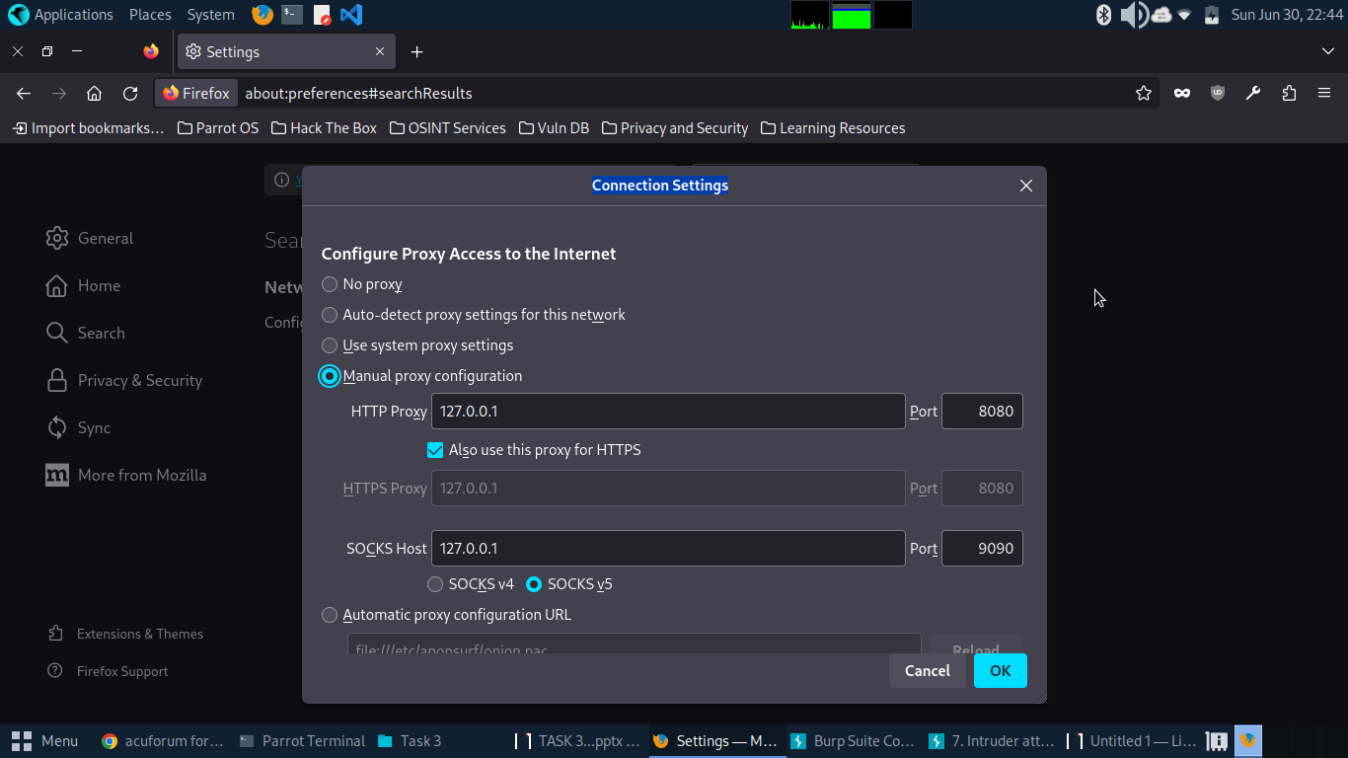

Slide 5
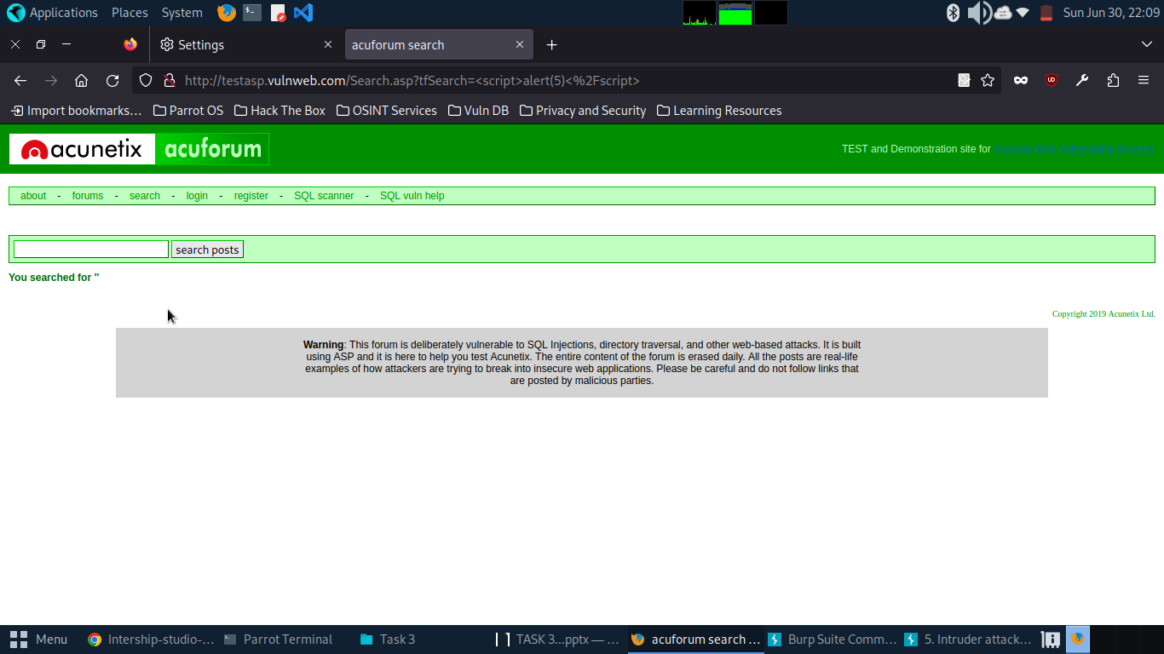

Slide 6
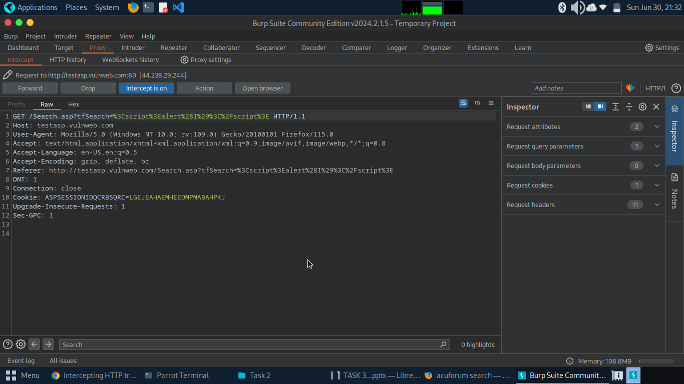

Slide 7
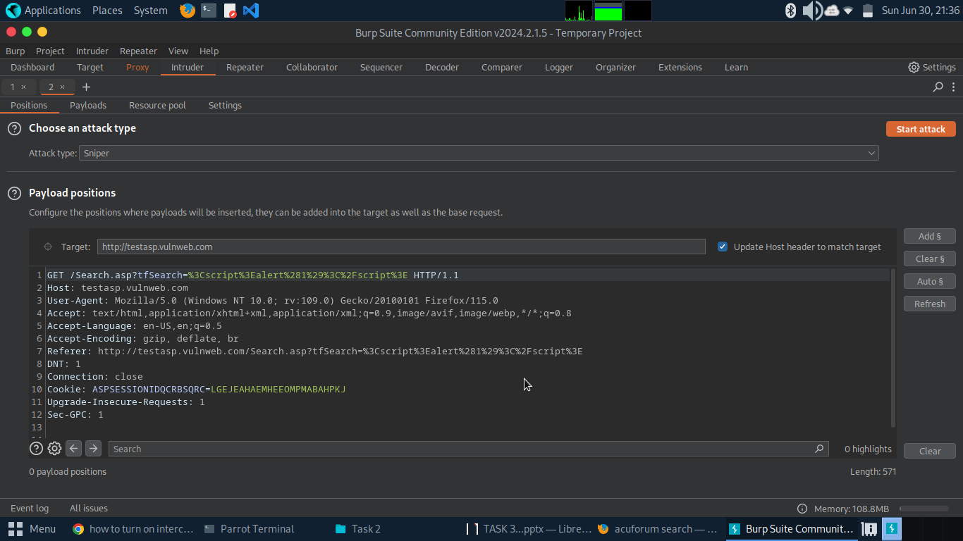

Slide 8
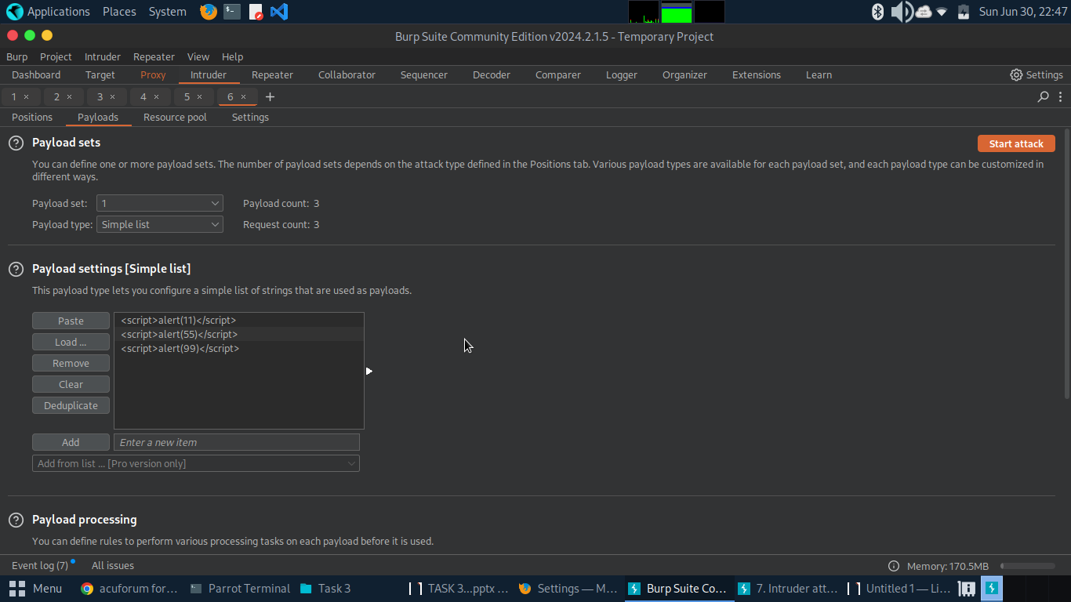

Slide 9
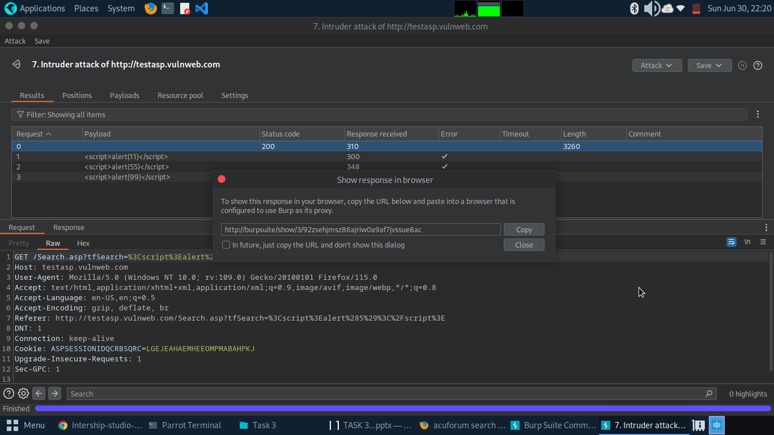

Slide 10
